Slide 1

State Management
Vuex - State, Getters, Mutations and Actions
SoftUni Team
Technical Trainers
Software University
https://softuni.bg

Slide 2
Table of Contents
State Management
Centralized State Pattern
Vuex
State & Getters
Mutations
Actions
Modules
2

Slide 3
Have a Question?
sli.do #js-frameworks

Slide 4

State Management
Why Do We Need It?

Slide 5
Centralized State Management
The state - the single source of truth that drives our app
The view - a declarative mapping of the state
The actions - the possible ways the state could change
Usually needed for medium to large scale SPA
"Flux libraries are like glasses: you'll know when you need them." - Dan Abramov
5

Slide 6
The Problem: Communication
Parent
Emit an Event
Pass Props
ChildA
Child
C
Child
B
Emit an Event
Sub-Child A
Pass from Sub-Child A to Child C
6

Slide 7
The Solution: Centralized State
Parent
Store
ChildA
Child
C
Child
B
Sub-Child A
Mutate the state

Slide 8

Vuex
State Management Pattern for Vue

Slide 9
Definition
Vuex is a state management pattern + library for Vue.js applications
Serves as a centralized store for all the components in an application
State can only be mutated in a predictable fashion
9

Slide 10
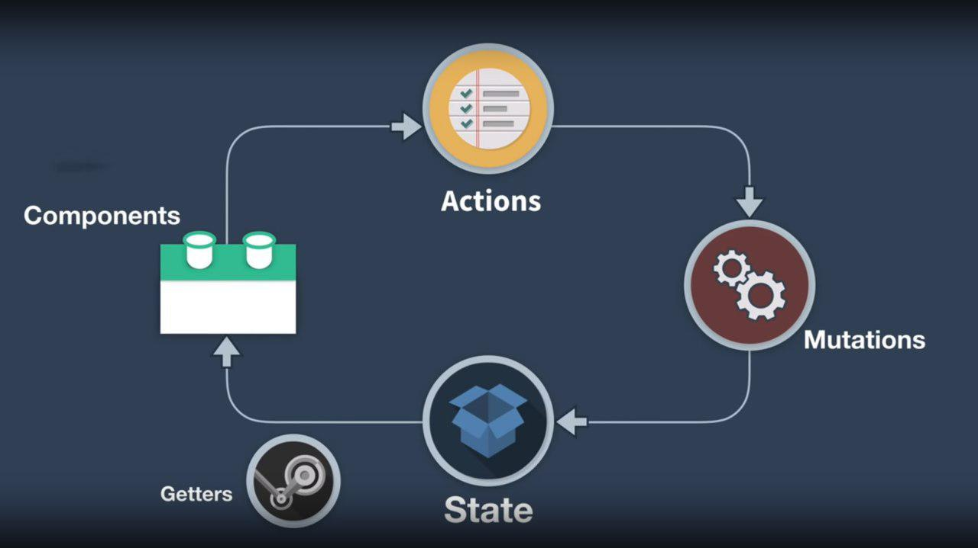
How It Works?

Slide 11
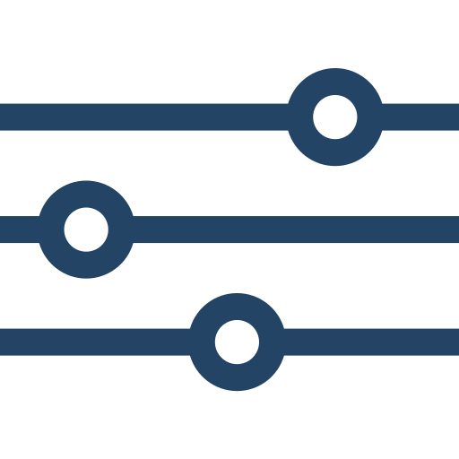
Setup Store
Create a store.js and inside initialize the state
import Vue from 'vue';
import Vuex from 'vuex';
Vue.use(Vuex);
export const store = new Vuex.Store({
state: {
counter: 0
}
});
11

Slide 12

Import Store
Provide the store inside the root instance and that's it!
import { store } from './store/store';
new Vue({
el: '#app',
store
}).$mount('#app')
12

Slide 13
The $Store Property
You can access & modify the state directly
Not recommended
computed: {
counter() {
return this.$store
.state.counter;
}
}
methods: {
increment() {
return this.$store
.state.counter++;
}
}
13

Slide 14
Access State Via Getters
Use getters to read the state
getters: {
counter: (state) => {
return state.counter;
},
doubledCounter: (state) => {
return state.counter * 2;
}
}
counter() {
return this.$store
.getters.counter;
}
14

Slide 15
Change State Via Mutations
Use mutations to change the state
mutations: {
increase: (state, payload) => {
state.counter += payload;
},
decrease: (state, payload) => {
state.counter -= payload;
}
}
Usually an object
methods: {
increment(val) {
this.$store
.commit('increase', val);
},
}
15

Slide 16
Asynchronous Mutations Via Actions
Usually we dispatch actions to mutate the state (async data)
actions: {
asyncIncrease: (context, payload) => {
setTimeout(() => {
context.commit('increase', payload);
}, 1000);
}
}
Mutation method name
This.$store.dispatch('asyncIncrease', value)
16

Slide 17
Helper Functions
Use the mapGetter, mapMutations and mapActions helper functions to minimize boilerplate code
computed: {
...mapGetters([
'counter',
'doubledCounter'
])
// Add other properties
}
computed: mapGetters([
'counter',
'doubledCounter'
])
17

Slide 18
Form Handling
Handle input with v-model using a computed setter
<input v-model="value" type="text" />
<p>{{ value }}</p>
computed: {
value: {
get() { return this.$store.getters.value; },
set(value) { this.$store.commit('updateValue', value); }
}
}
18

Slide 19

Modules
Due to using a single state tree, all state of the application is contained inside one big object
However, as our application grows in scale, the store can get really bloated
19

Slide 20
Modules (2)
To help with that, Vuex allows us to divide our store into modules
Each module can contain its own state, mutations, actions, getters, and even nested modules

Slide 21
Create a Module
Export an application piece into a module
export const counterModule = {
state: {},
getters: {},
mutations: {},
actions: {}
}
modules: {
counter: counterModule
}
21

Slide 22
Module Namespacing
By default everything is registered under the global namespace
Create more self-contained modules using namespacing
modules: {
counter: {
namespaced: true,
state: counterModule.state
// Add getters, mutations, actions
}
}
22

Slide 23
Add Module to Views
Fix view layer to locate module
get() {
return this.$store
.getters['counter/value'];
},
set(value) {
this.$store.commit(
'counter/updateValue', value);
}
computed: {
...mapGetters('counter', [
'counter',
'doubledCounter'
])
}
23

Slide 24

Summary
…
…
…
Vuex - state management library
Getters - retrieve data from store
Mutations - change store data
Actions - commit mutations / async operations
Modules - split store object

Slide 25
Questions?
Notes:
25

Slide 26












SoftUni Diamond Partners

Slide 27




SoftUni Organizational Partners

Slide 28
Trainings @ Software University (SoftUni)
Software University - High-Quality Education, Profession and Job for Software Developers
softuni.bg, softuni.org
Software University Foundation
softuni.foundation
Software University @ Facebook
facebook.com/SoftwareUniversity
Software University Forums
forum.softuni.bg
28
Notes:
28

